Slide 1


模拟电子技术基础
Analog Device
7.1 Signal operation
信号的运算
陈晓龙 Chen, Xiaolong
Department of Electrical and Electronic Engineering

Slide 2














7.1 Basic signal operational circuits
Signal operation: The output voltage is a result of the operation of input voltage, such as addition, subtraction, division, multiplication, integration…
Use negative feedback and operational amplifier
Ideal operational amplifier
Virtual short circuit
Virtual open circuit

Slide 3












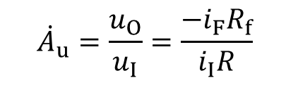
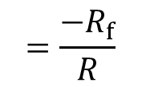



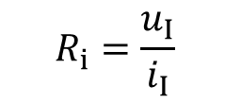

7.2 Scaling operational circuit 比例运算电路
(1) Inverted input 反相输入
a. Which type feedback connection?
b. Voltage gain?
c. Input resistance?
Virtual short circuit
Virtual open circuit

Slide 4






















(1) Inverted input 反相输入
Keep the symmetry of the input circuit
The input resistance at P should equal to that at N

Slide 5













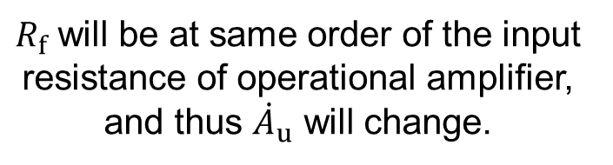
(1) Inverted input 反相输入
e. The drawback of the circuit
The noise and stability of resistor will be poor.

Slide 6









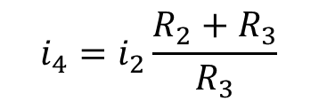
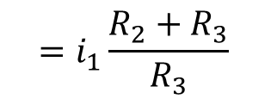






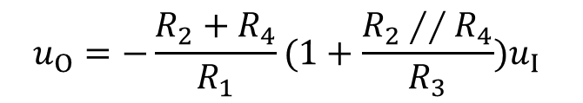
(2) T-shape feedback network inverted input T型反馈网络反相输入
a. Voltage gain:

Slide 7












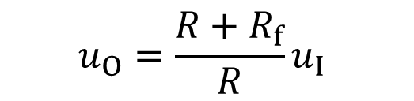
(3) Non-inverted input 同相输入
Voltage gain:

Slide 8














(3) Non-inverted input: Voltage follower 电压跟随器

Slide 9









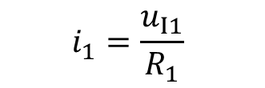

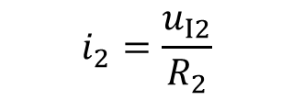



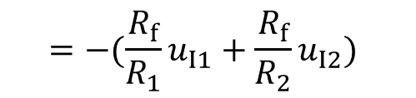
7.3 Addition operation 加法运算
(1) Inverted input 反相输入
Virtual short circuit
Virtual open circuit

Slide 10










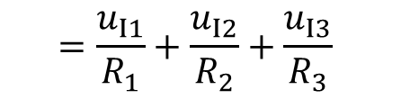







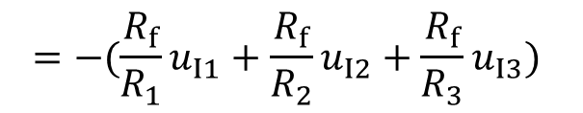


Slide 11












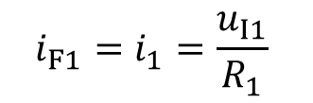
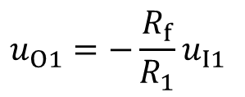








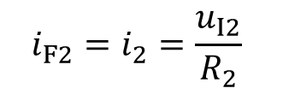
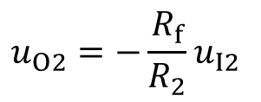


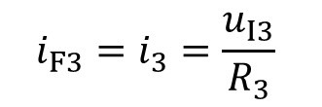
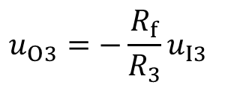
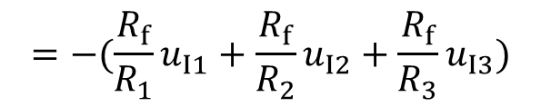
Superposition method 叠加法

Slide 12













The symmetry of input circuit

Slide 13













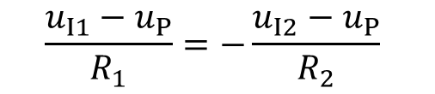



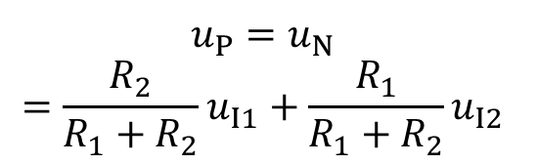


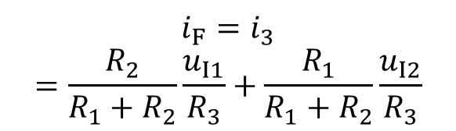
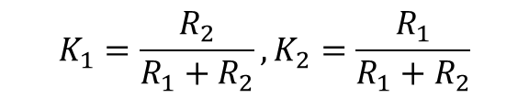
(2) Non-inverted input 同相输入

Slide 14















The symmetry of input circuit

Slide 15



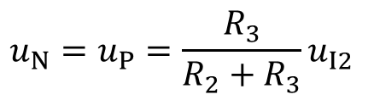










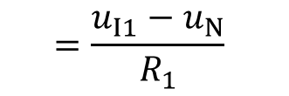

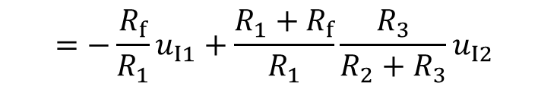
7.4 Subtraction operation 减法运算

Slide 16


















The symmetry of input circuit
Special case:

Slide 17







































Superposition method 叠加法
Non-inverted input scaling operational circuit
Inverted input scaling operational circuit

Slide 18














7.5 Addition and subtraction mixed operation 加减法混合运算
How to realize
Non-inverted input
Inverted input

Slide 19

























































Superposition method 叠加法
Non-inverted input
Inverted input

Slide 20






































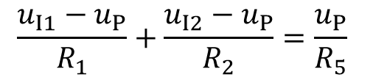
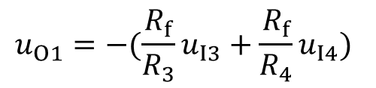

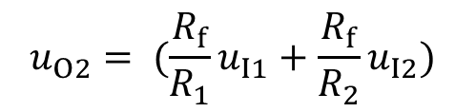
Non-inverted input
Inverted input

Slide 21





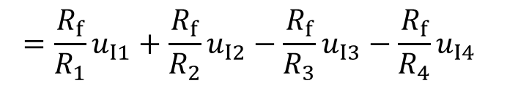


















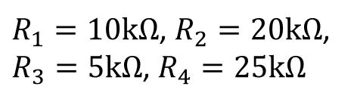
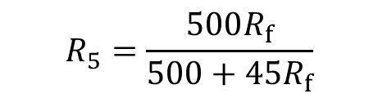

How to realize

Slide 22
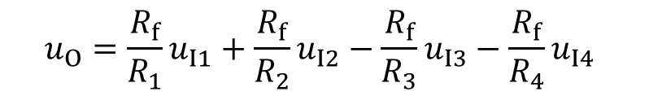


Can this circuit realize
with A, B, C and D>0?

Slide 23
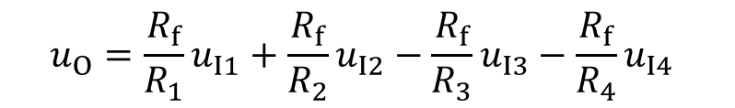



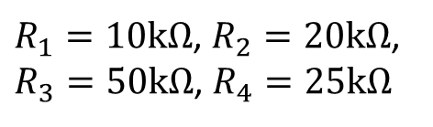
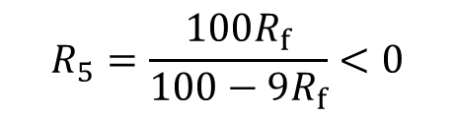

Slide 24














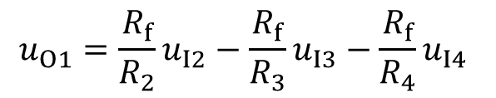


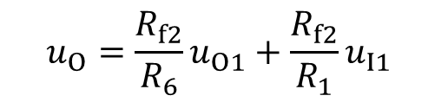




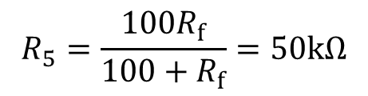

Slide 25



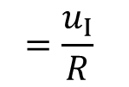







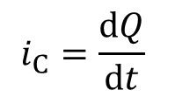
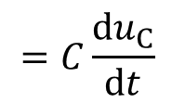




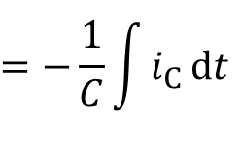
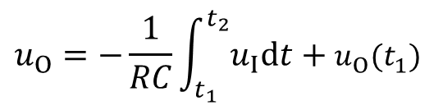
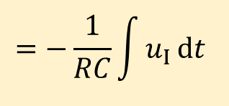
7.6 Integration operation 积分运算
From time t₁ to t₂ :

Slide 26
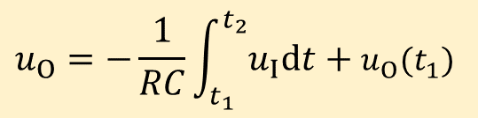




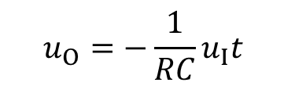





(2) Square to triangular wave transition
(1) Step signal 阶跃信号
0
0
0
0

Slide 27
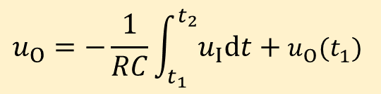

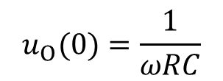






(3) Sin to Cos wave transition (Phase shift 180º)
0
0

Slide 28

















7.7 Differential operation 微分运算

Slide 29
















(1) Step signal
0
We expect:
Real case:
0
0
The amplifier enters saturation or cut-off region

Slide 30







Applicable differential operation
Stabilize circuit
0
0

Slide 31






(2) Square wave
0
0

Slide 32












Use inverse function to realize differential operation
用逆函数实现微分运算

Slide 33









Use inverse function to realize differential operation
Integration operation
Differential operation

Slide 34










7.8 Logarithm operation 对数运算
(1) Use diode

Slide 35









(2) Use transistor
c
b
e

Slide 36









7.9 Exponent operation 指数运算
c
b
e

Slide 37
Example: Use operational amplifier to realize the function below and draw the circuit. Requirement: use 3 Op Amps, and the value of component is listed below:

Slide 38


Example: Use operational amplifier to realize the function below and draw the circuit. Requirement: use 3 Op Amps, and the value of component is listed below:
Answer:

Slide 39



Slide 40


Slide 41




7.10 Analog multiplier 模拟乘法器
K
X
To realize multiplication function 实现乘法运算

Slide 42








(1) Multiplication operation using logarithms amplifier 对数乘法器
K
X

Slide 43









Logarithm operation
Addition operation
Exponent operation
Logarithm operation

Slide 44























Multiplication operation using logarithms amplifier

Slide 45




Multiplication operation using logarithms amplifier
0

Slide 46












(2) Variable transconductance multiplier 变跨导式乘法器
Working principle: using differential amplifier
+V_{CC}
R_{C}
R_{C}
T1
T2
-V_{EE}

Slide 47

















Differential amplifier with constant-current source as a multiplier
+V_{CC}
R_{C}
R_{C}
T1
T2
T3
R_{E}

Slide 48















Dual-terminal to single-terminal
+V_{CC}
R_{C}
R_{C}
T1
T2
T3
Dual-terminal
Single-terminal
R_{E}

Slide 49







Drawback
(a)
0
Two-quadrant
(b)

Slide 50









Four-quadrant 四象限：
0

Slide 51




(3) Application of Multiplication amplifier
a) Square operation 平方运算
K
X

Slide 52





a) Square operation 平方运算
K
X
Double the output frequency!

Slide 53










b) Cubic operation 立方运算
X
X
K
K
c) The 4th-power operation 四次方运算
X
X
K
K

Slide 54












d) How to realize n^{th}-power operation?
Logarithms operation
X
Exponent
operation

Slide 55







f) Square root (Sqrt) operation 开平方运算
X
K

Slide 56








g) Division operation 除法运算
X
K

Slide 57
Homework：7.3，7.9，7.11，7.12，7.17，7.18

